Slide 1
Before we Start
Install Arduino Software if you haven’t (Use the USBs)
Connect Arduino to computer with blue cable
Open Arduino Software
Goto Tools -> Board -> Arduino/Genuino Uno
Goto Tools -> Port -> Select the Arduino from the list
Goto File -> New
Goto Sketch -> Upload
Let me know when you’re done.

Slide 2
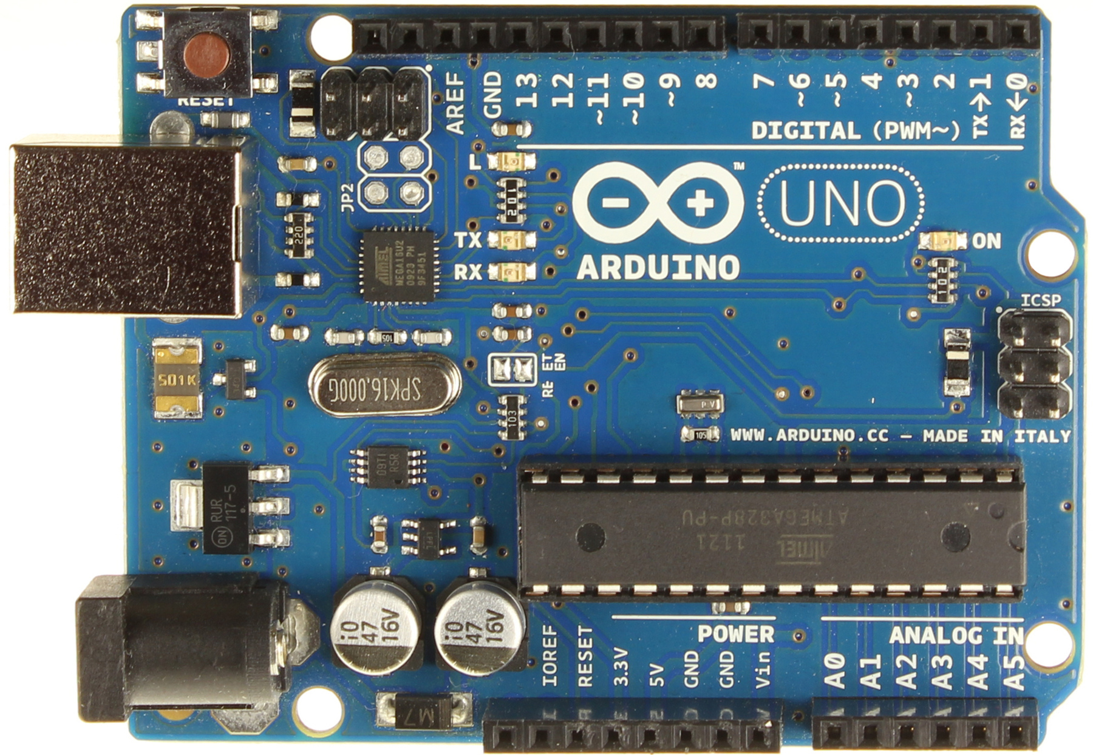
Introduction to Arduino
by Travis Bumgarner
Travis.Bumgarner@Gmail.com

Slide 3

Workshop Overview
Introductions
Goals
Learn about electronics, programming, and safety.
Practice with tools and components
More advanced Topics

Slide 4
?
Introductions
Who are you?
Where do you come from?
What do you do for work?
Why did you come today?

Slide 5
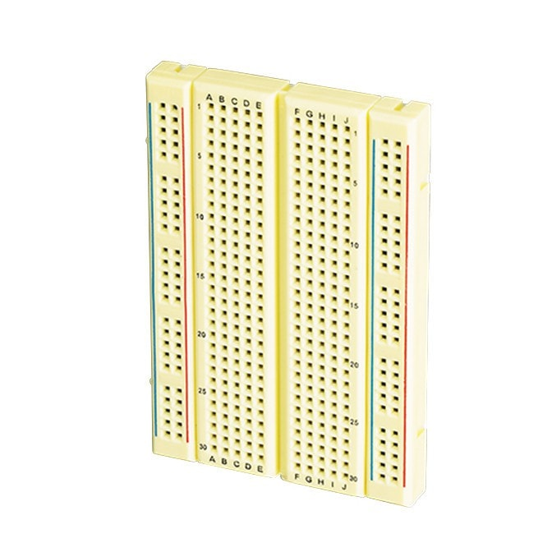
Knowledge Level
for(var i = 0; i <10; i++){
sum = sum + 5;
Serial.println(sum);
}
for i in range(0,10):
sum += 5;
print(“The number is” + str(i))
Notes:
Raise your hand if…
Breadboard
For Loop

Slide 6

Security
Electricity is dangerous
Short circuits

Slide 7
!
Possibilities
Inputs – Sensors, buttons, cameras, joysticks
Outputs – Motors, Screens
https://www.youtube.com/watch?v=nZtfW2e2Cp0
Notes:
Explain the components used in the video and the other parts that aren’t Arduino.

Slide 8
An example without code: Lightswitch
Notes:
The Process
Install the lightbulb
Install the light switch
Choose the direction
Run cable
Setup vs Loop

Slide 9
An example without code: Waterfall
Notes:
Voltage
Current
Resistance

Slide 10
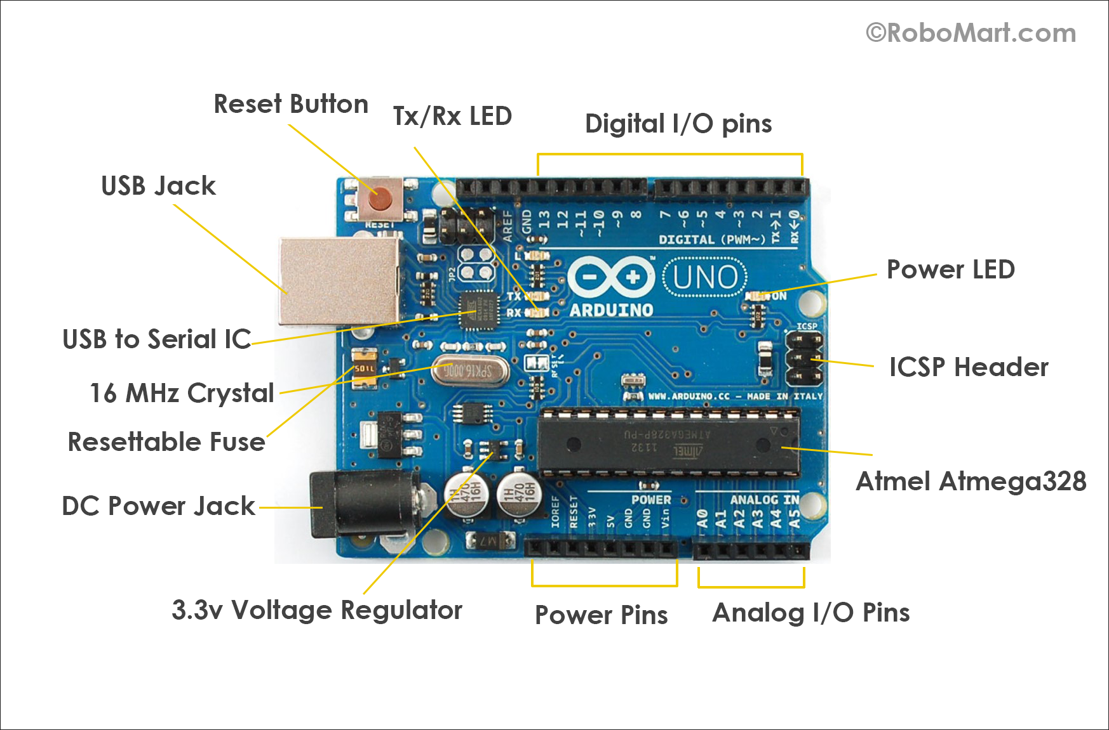
Circuit 1: The Parts

Slide 11
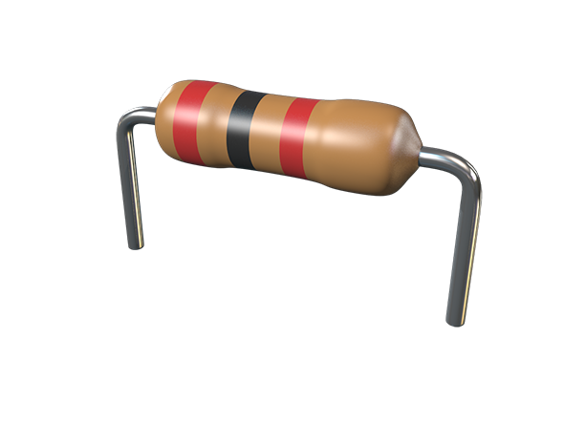
Circuit 1: The Parts
Resistence
Measured in ohms
Symbol (Ω)
1000 Ω = 1KΩ
1000KΩ = 1 MΩ
Identification Colors

Slide 12
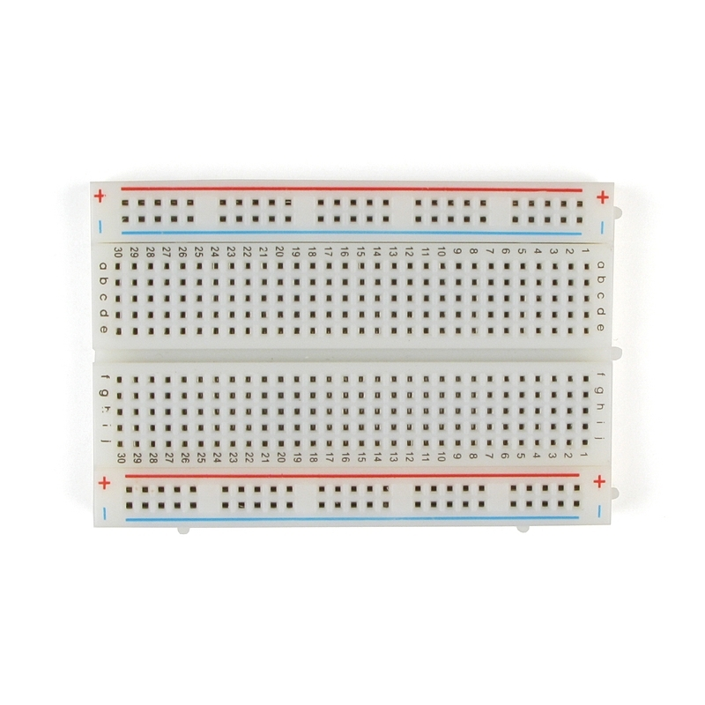
Circuit 1: The Parts
Breadboard
Notes:
Show how it’s connected

Slide 13
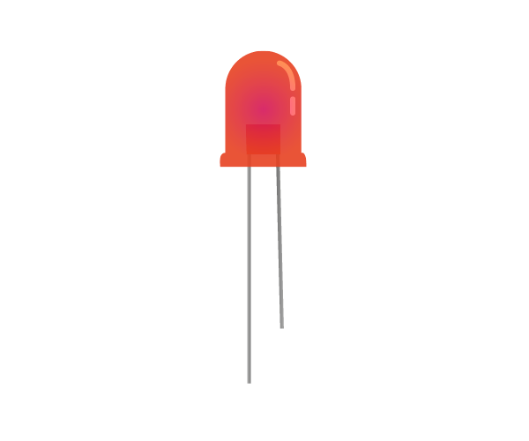
Circuit 1: The Parts
LEDs
-
+
Notes:
Positive Side
Negative Side
Resistance

Slide 14
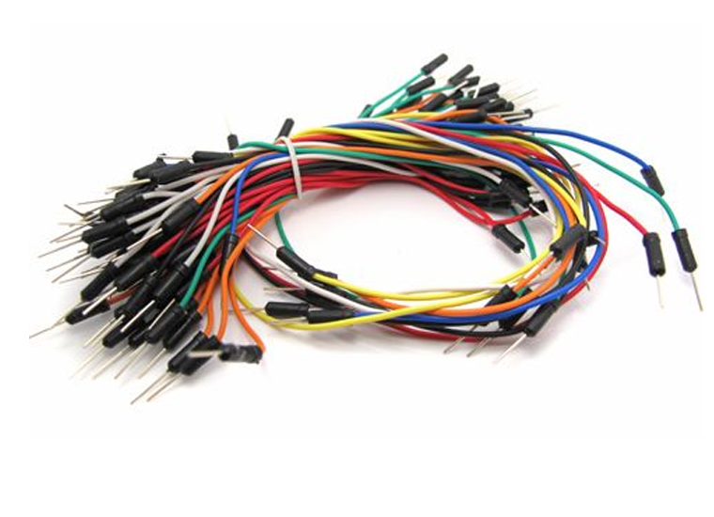
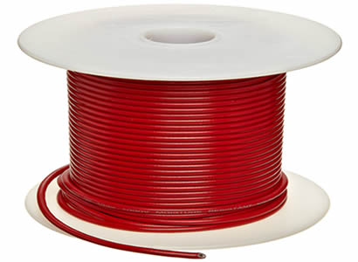
Circuit 1: The Parts
Wires

Slide 15
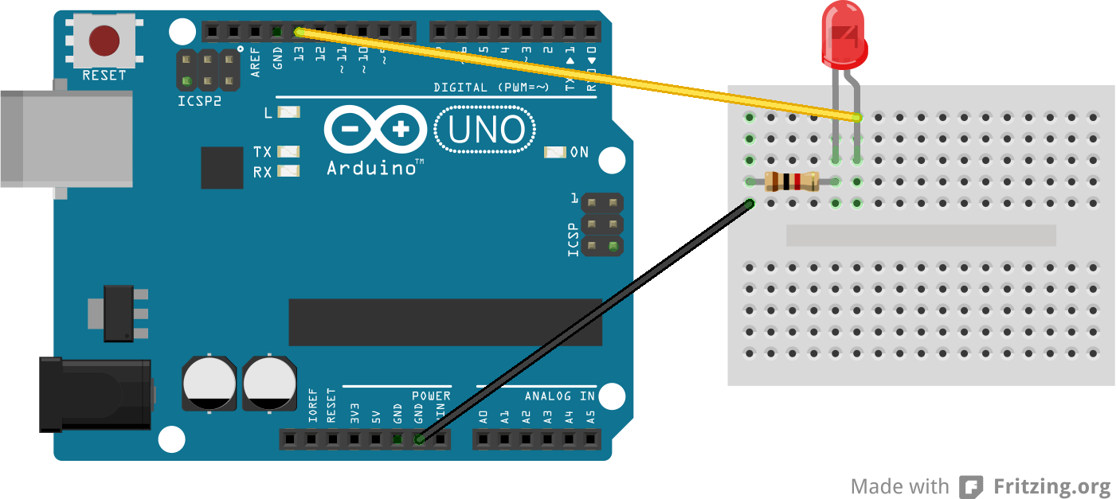
Circuit 1: The Breadboard
Google – Blink LED Arduino

Slide 16
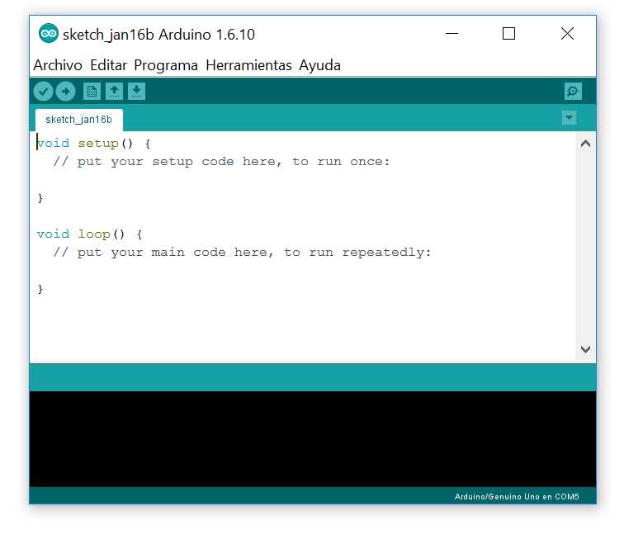
Circuit 1: The Code
Notes:
Explain the various parts of the editor

Slide 17
Circuit 1: The Code
/* My First Project
Written by Travis Bumgarner
*/
void setup() {
//This is the setup
}
void loop() {
}
Notes:
Start with an empty file
Each function has setup and loop…
Single and multiline comments

Slide 18
Circuit 1: The Code
/* My First Project
Written by Travis Bumgarner
*/
int ledGreen = 13;
void setup() {
//This is the setup
}
void loop() {
}
Notes:
Variable consists of 5 parts.

Slide 19
Circuit 1: The Code
int ledGreen = 13;
void setup() {
pinMode(ledGreen, OUTPUT);
}
void loop() {
digitalWrite(ledGreen, HIGH);
}
Notes:
pinMode(variable, INPUT)
Input, output
Input: something you receive information from
Ouptput: something you send information to
Input -> digitalRead()
Output -> digitalWrite()
High, Low (On, Off)
digitalWrite(myFirstLed,HIGH)
- Upload Sketch

Slide 20
Circuit 1: The Code
int ledGreen = 13;
void setup() {
pinMode(ledGreen, OUTPUT);
}
void loop() {
digitalWrite(ledGreen, HIGH);
delay(1000);
digitalWrite(ledGreen , LOW);
delay(1000)
}
Notes:
If there’s time…
ledBlinkRate = ledBlinkRate + 50;
- If statement

Slide 21
Problem Solving
What problems did you have?
Notes:
Bring out the whiteboard and discuss problems
If no issues (ha ha)…
Raise hand
LED Direction
Shorts (burned out an LED)
Wiring breadboard
Resistance values
Is there power
Using a multimeter

Slide 22
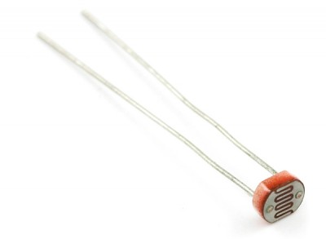
Circuit 2: New Components
Photoresistor…
What is it?
Notes:
Google: Photoresistor
Get good at google
Steps
Read comments
Wire Up
Explain Serial
Copy previous example, switch pin for Arduino
Either move wire to new pin or change in sketch

Slide 23
Resources
Cambridge Hackspace Tuesday Nights
Adafruit.com sparkfun.com arduino.cc microcenter.com https://circuits.io/
Notes:
Google: ejemplo de photoresistencia arduino

Slide 24

The next step!
Select a Project and jump in!

